Slide 1
RUNGTA COLLEGE OF DENTAL SCIENCES & RESEARCH
TITLE OF THE TOPIC- DIE MATERIALS
DEPARTMENT OF CONSERVATIVE DENTISTRY AND ENDODONTICS

Slide 2
Specific learning Objectives
At the end of this presentation the learner is expected to know ;
Core areas* | Domain ** | Category #
Introduction | Cognitive | Must know
Method | Psychomotor | Must know
Armamentarium | Cognitive | Must know
*Subtopic of importance
** Cognitive, Psychomotor or Affective
# Must know , Nice to know & Desire to know
( Table to be prepared as per the above format )

Slide 3
CONTENTS
Introduction
Ideal requisites of die materials
Classification of die materials
Different die materials
Different die systems
Conclusion
References

Slide 4
INTRODUCTION :
Die is the positive reproduction of the form of a prepared tooth in any suitable substance.
A die must be an accurate reproduction of the prepared tooth both in dimensions and surface details.
It must represent all of the prepared surfaces, including the margins and a reasonable amount of the uncut apical position of the tooth.

Slide 5
A die must be made of a material that is
Dense
Hard
Capable of being used in the production of wax patterns and in the fitting and finishing of castings without undue risk of damage to its surface.

Slide 6
Because direct fabrication of patterns for extracoronal restorations in the mouth is
inconvenient
Difficult
Time consuming
Virtually impossible, practically all wax patterns are made in the laboratory with the indirect technique.

Slide 7
IDEAL REQUISITES OF A DIE MATERIAL :
Die material should be compatible with the impression materials.
Dimensional accuracy and stability – material should remain dimensiona-lly stable on storage.

Slide 8
3. Reproduction of detail – The ability to reproduce fine detail and sharp margins is essential.
Mechanical properties – High strength is important.
Color-Good color contrast with other materials being used.

Slide 9
Toughness -To allow burnishing of foil and resist breakage.
Easy and quick manipulation and rapid fabrication.
Non-injurious to health by touch or inhalation.
All surfaces must be accurately duplicated and no bubbles or voids can be accepted.
Economical.

Slide 10
CLASSIFICATION OF DIE MATERIALS :
1. Inorganic materials
Die stone, based on calcium sulfate hemihydrate Eg. Velmix
Dental cement – zinc silicophosphate
Ceramic materials, fired at 600⁰C.
2. Metallic materials
Dental amalgam
Metal sprayed dies (Bismuth-tin alloy)
Electroplated dies
Copper plated
Silver plated

Slide 11
Dental gypsum products are available in 5 forms (ADA Types I to V)
Type I – Impression plaster
Type II – Model plaster
Type III – Dental stone (Class I stone or Hydrocal)
Type IV – High-strength dental stone (class II stone, densite, or improved stone)
Type V – High strength, high expansion stone.

Slide 12
The die stone is relatively *Inexpensive *Easy to use *Compatible with all impression materials. Disadvantage * Susceptibility to abrasion during the carving of the wax pattern.
ADVANTAGES

Slide 13
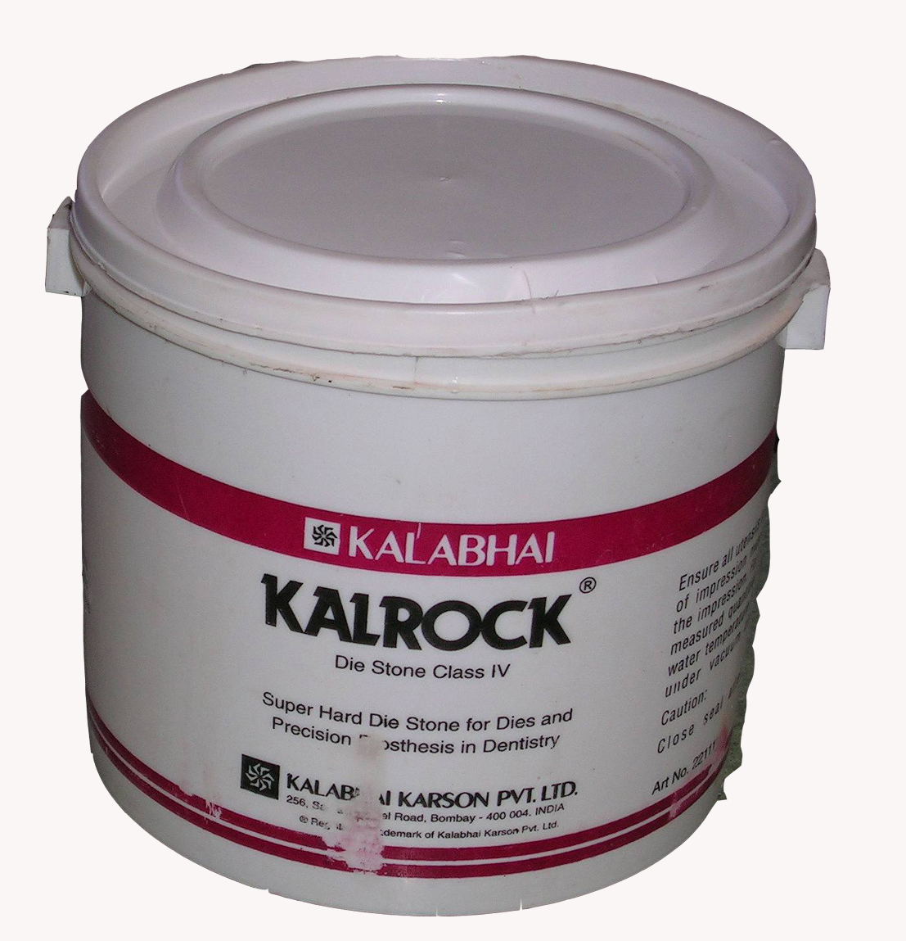
DIE STONE

Slide 14
* Gypsum hardeners, such as aqueous colloidal silica or soluble resin restorations, can be used instead of water during mixing of the stone. * Resistance to abrasion is increased by approximately 100%. * Disadvantage is the slightly increased setting expansion.
Variations in Die techniques and materials :
* Several means are used to increase the resistance to abrasion.

Slide 15
In this the die material and the investing medium have a comparable composition. A commercial gypsum – bonded material called divestment is mixed with a colloidal silica liquid. The die is made from this mix and the wax pattern is constructed on it.
Die stone – investment combination

Slide 16
Divestment is a gypsum-bonded material, it is not recommended for high-fusing alloys.
“Detail reproduction, contact angle and die hardness of elastomeric impression and gypsum die material combinations.”
This study compared the surface detail parameters, interfacial contact angle and die hardness for some combinations of polyvinyl siloxanes, polyether, polysulfide and reversible hydrocolloid impression materials and type IV, Type V and resin reinforced – type IV stone.

Slide 17
Adequate detail reproduction of prepared teeth may be achieved with the combination of any of the elastomeric impression materials with any of the die stone materials tested.
When using polyvinyl siloxane or polyether impression material, type IV-resin reinforced die stone may produce dies that are less scratch resistant on the surface than the type IV die stone used in this study.
No overall combination of die and impression materials was identified as superior to another for all of the surface properties studied.

Slide 18
Electroplated Dies / Electroformed Dies :
Used to overcome the poor abrasion resistance of gypsum.
Advantages
High strength,
Hardness
Abrasion resistance.
The time required to produce a cohesive film of metal typically 8 hrs

Slide 19
TAKE HOME MESSEGE/ FOR THE TOPIC COVERED (SUMMARY)
The ease with which a restoration is fabricated and the accuracy with which it will fit the mouth is materially affected by the casts and dies.
So a die material should be selected that has
Good dimensional accuracy,
Abrasion resistance and
Ability to reproduce fine detail and sharp margins.

Slide 20
Question & Answer Session
Write in brief about die preparation.
Write a short note on dowel pins.
Write a short note on die stone.
Write in brief ideal requirements of die materials.

Slide 21
REFERENCES
Johnston’s – Modern practice in fixed prosthodontics.
Dental materials- Properties and manipulation – Craig, Obrein, Powers, 5th Edition.
Restorative dental materials – Robert, G. Craig and John H. Powers, 11th Edition.
Anusavice - Phillips Sciences of Dental materials, 10th Edition.
Contemporary fixed prosthodontics – Stephen F. Rosenstiel – 3rd Edition.
IJP 2000 Vol 13, No: 3 pp: 214-20.
JPD 2000 Apr; Vol 83 No: 4 pp: 466-73.
JPD 2000 Mar; Vol 83 No. 3 pp: 301-5.
JPD 1998 Oct; Vol 80 No. 4 pp: 485-9.

Slide 22
THANK YOU

